Slide 1
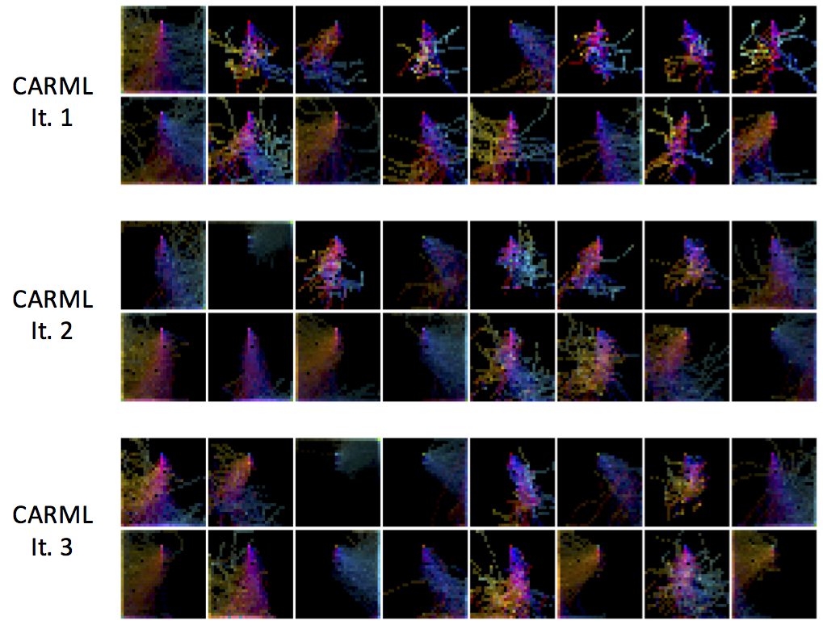
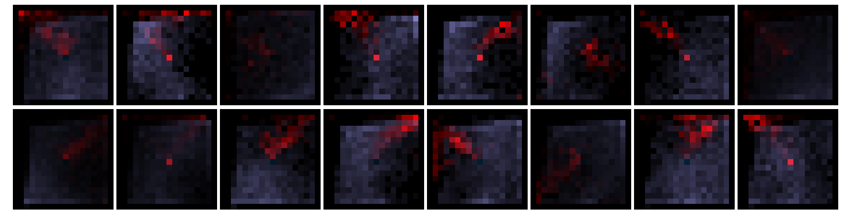
Unsupervised Curricula for Visual Meta-Reinforcement Learning Allan Jabri, Kyle Hsu, Ben Eysenbach, Abhishek Gupta, Sergey Levine, Chelsea Finn
Motivation: Can useful meta-RL tasks be discovered
in an unsupervised manner?
Experiments The acquired meta-RL strategies transfer to downstream test task distributions
Direct Transfer and Task-Specific Finetuning
Idea: Discover learnable tasks via information maximization
between a meta-learner and a self-generated task distribution.
VizDoom
Meta-Pretraining: Accelerate Supervised Meta-RL
Evolution of the Task Distribution
Key Challenges:
Mode-collapse of task distribution in high-dimensional observation spaces.
Joint task acquisition and meta-learning.
Structure and Diversity in task distribution.
Sawyer
Looking Forward
No free lunch -- Semi-supervised!
Non-visual task semantics
Convergence and Early Stopping
Forgetting
Simplifying Assumption. Conditional independence of observations
along our trajectories

